Slide 1
Growth Languages & Multimodality
JSALT-2025

Slide 2
Spoiler Alert High-Level Goals: Not Just Data Collection
Data
Methods
Survey Available Resources
Good News: More than expected
Bad News: Mixed Quality
Re-use when possible
Create when necessary
Boot-Strapping
Take advantage of high resource langs
To make progress on growth langs
Three Boot-Strapping Tasks:
Zero-Shot
Few-Shot
One-vs-All Zero-Shot
Multi-Modal
Language
Vision
Speech

Slide 3

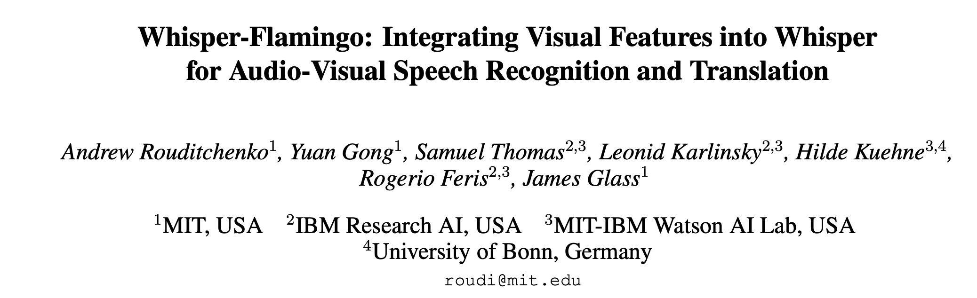

Slide 4
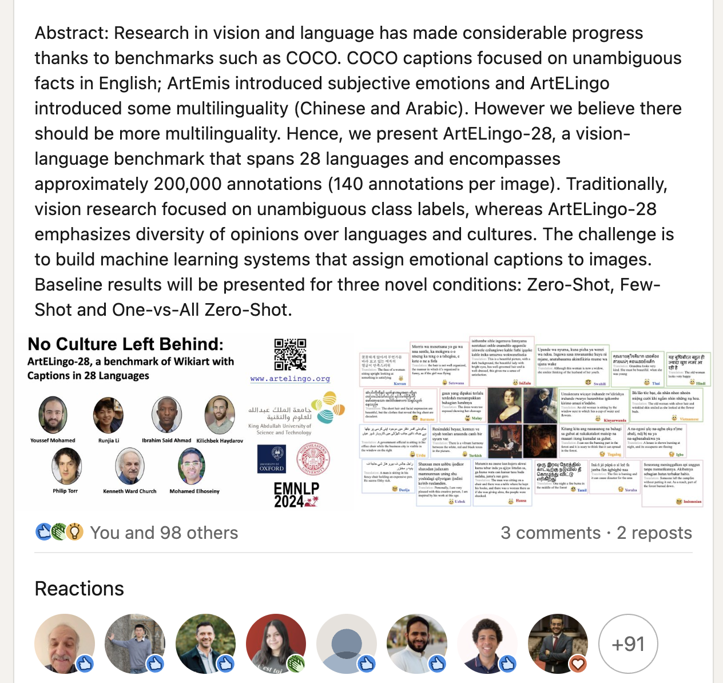

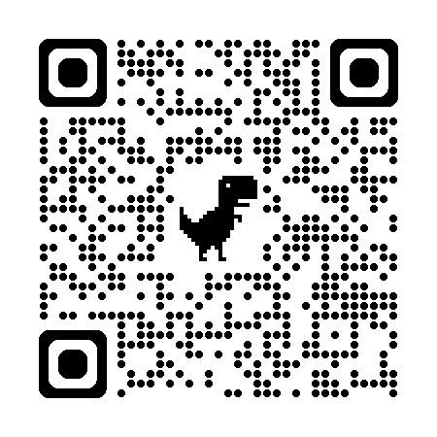
Lots of Interest from Lots of Places (104 Reactions) Benchmark + Baseline Results (not just data)
Baseline results will be presented for three novel conditions: Zero-Shot, Few-Shot and One-vs-All Zero-Shot
Hot Topic

Slide 5

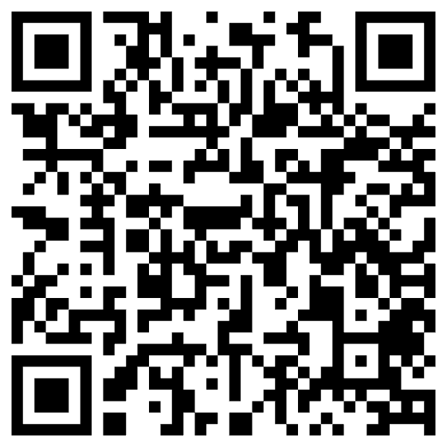
Criticism: ACL is too focused on English https://thegradient.pub/the-benderrule-on-naming-the-languages-we-study-and-why-it-matters/

Slide 6
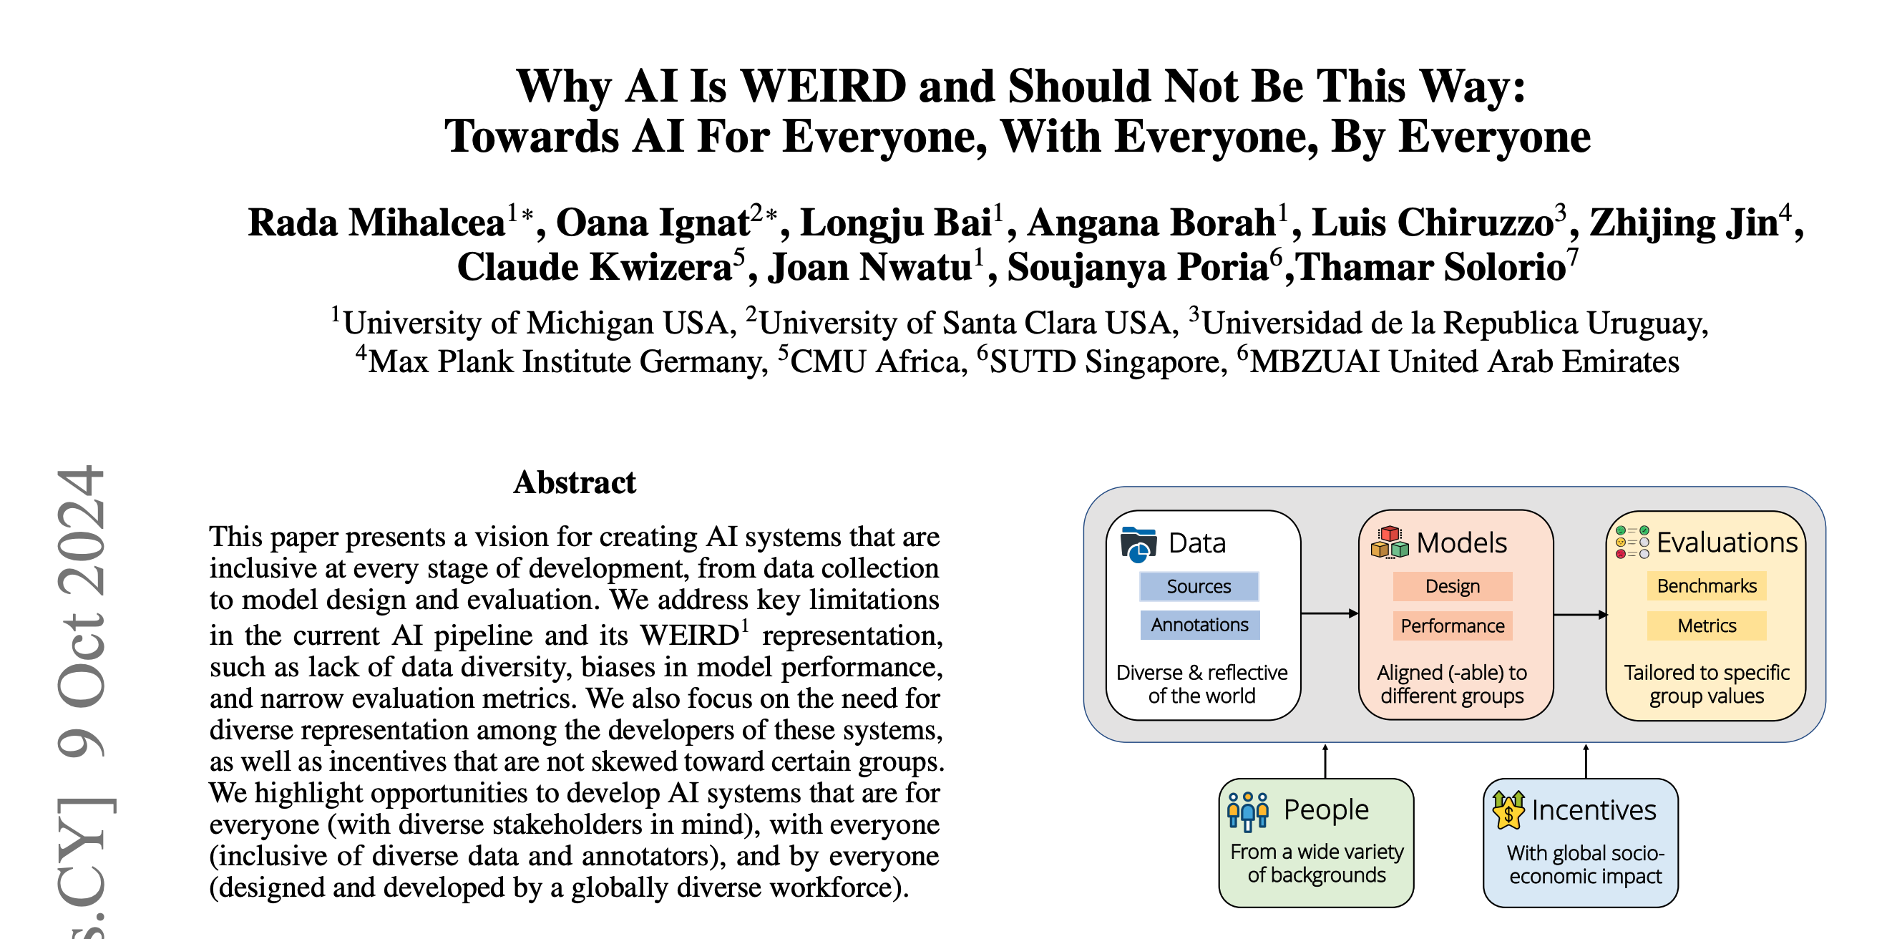
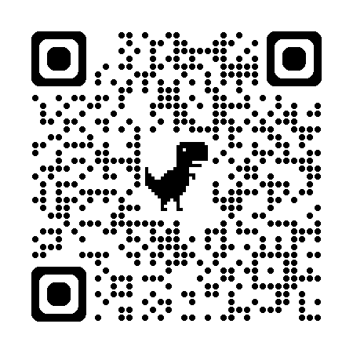
Weird = Western, Educated, Industrialized, Rich, and Democratic

Slide 7
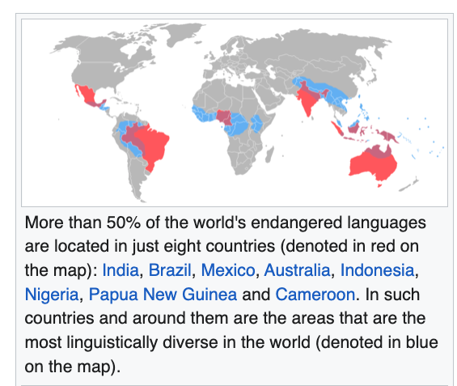
Low Resources & Growth Opportunities
Better Business Case
Endangered Languages
50 Million Speakers or more
English, Chinese, Hindi, Spanish, Arabic, French, Bengali, Portuguese, Russian, Urdu, Indonesian, German, Japanese, Nigerian Pidgin, Marathi, Telugu, Turkish, Hausa, Tamil, Swahili, Tagalog, Punjabi, Korean, Persian, Javanese, Italian, Gujarati, Thai, Amharic, Kannada, Bhojpuri
https://en.wikipedia.org/wiki/Endangered_language
https://en.wikipedia.org/wiki/List_of_languages_by_total_number_of_speakers

Slide 8
Long-Term Goal: Boot-Strap from High Resources to Growth Opportunities
High Resource: English, Chinese, etc.
Growth Opportunities: Languages with 40 Million Speakers
Eventually,
Port chatbots from English & Chinese to many more languages
And do so in a responsible way that embraces diversity/multimodality

Slide 9
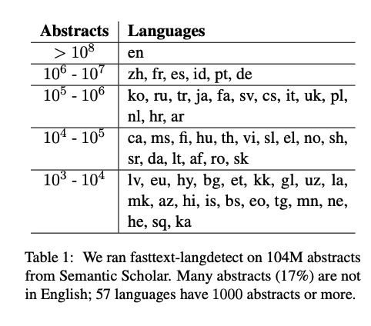
Good News
We have more resources
for growth languages in 2020s
than for English in 1990s
No Language Left Behind
Multilingual LLMs
Google Translate
Wikipedia (Common Crawl)
Common Voice (Speech)
Studio Kalangou (Speech)
ArteLingo (Vision)
Opus Parallel Text (Translation)
Abstracts in Semantic Scholar
Universal Dependencies
WordNet
Sketch Engine
87% English

Slide 10



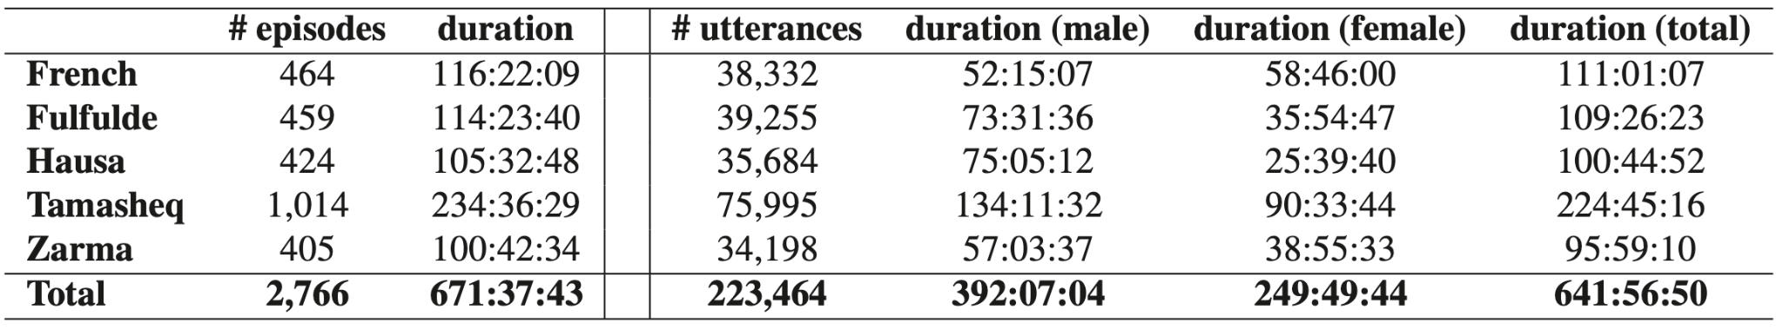

Slide 11
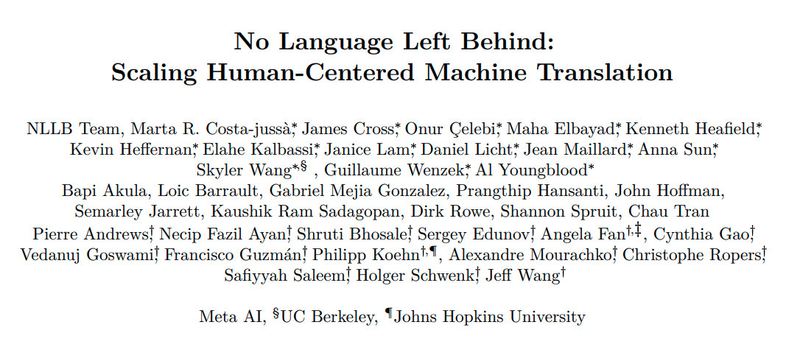
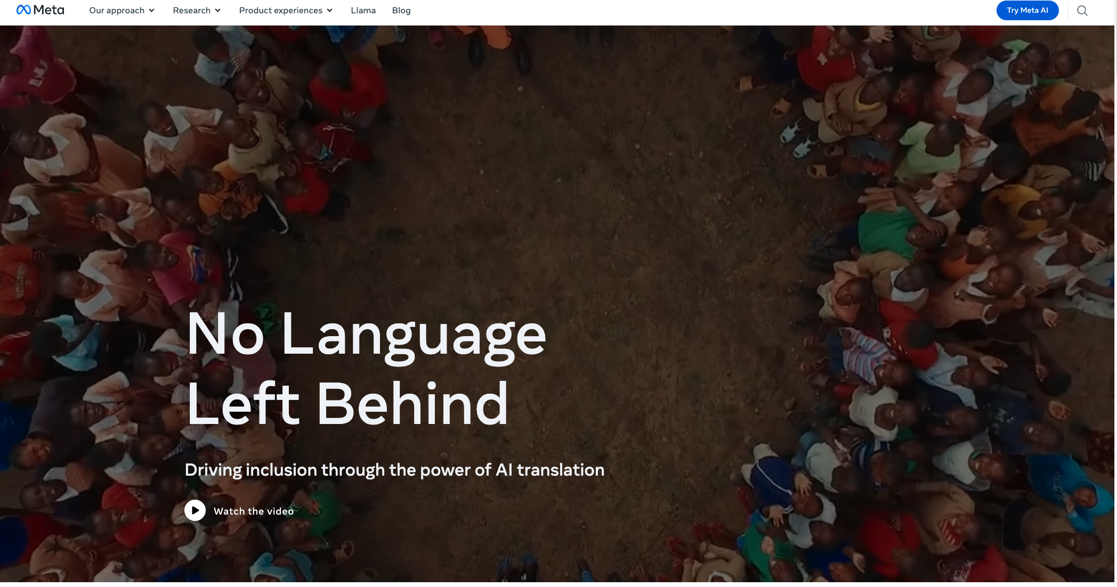
No Language Left Behind (NLLB)

Slide 12
Concerns
Responsible AI (deadly and insanely profitable)
Data quality
Too much machine translation
Too few quality controls (by people with local expertise)
Lack of Expertise in Languages and Cultures
Too much Emphasis on Translation
Is it appropriate to use English as a pivot language
Is there a single model to rule them all?
Covering multiple perspectives

Slide 13

Move Fast and Break Things (Colonialism)
Irresponsible AI

Slide 14
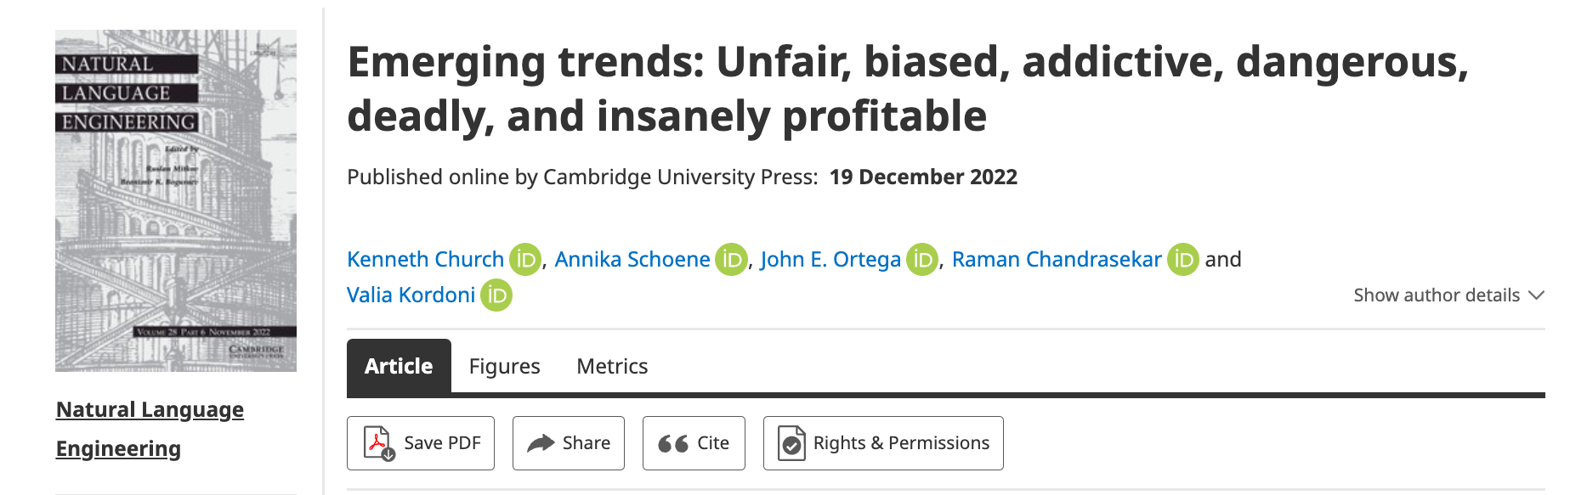



Responsible AI
Risks 1.0 (2016)
Unfair, Biased
Risks 2.0 (2022)
Addictive, Dangerous, Deadly and Insanely Profitable
American social media companies are not great at moderating online forums,
but they are worse in languages and cultures
that they do not understand all that well.

Slide 15
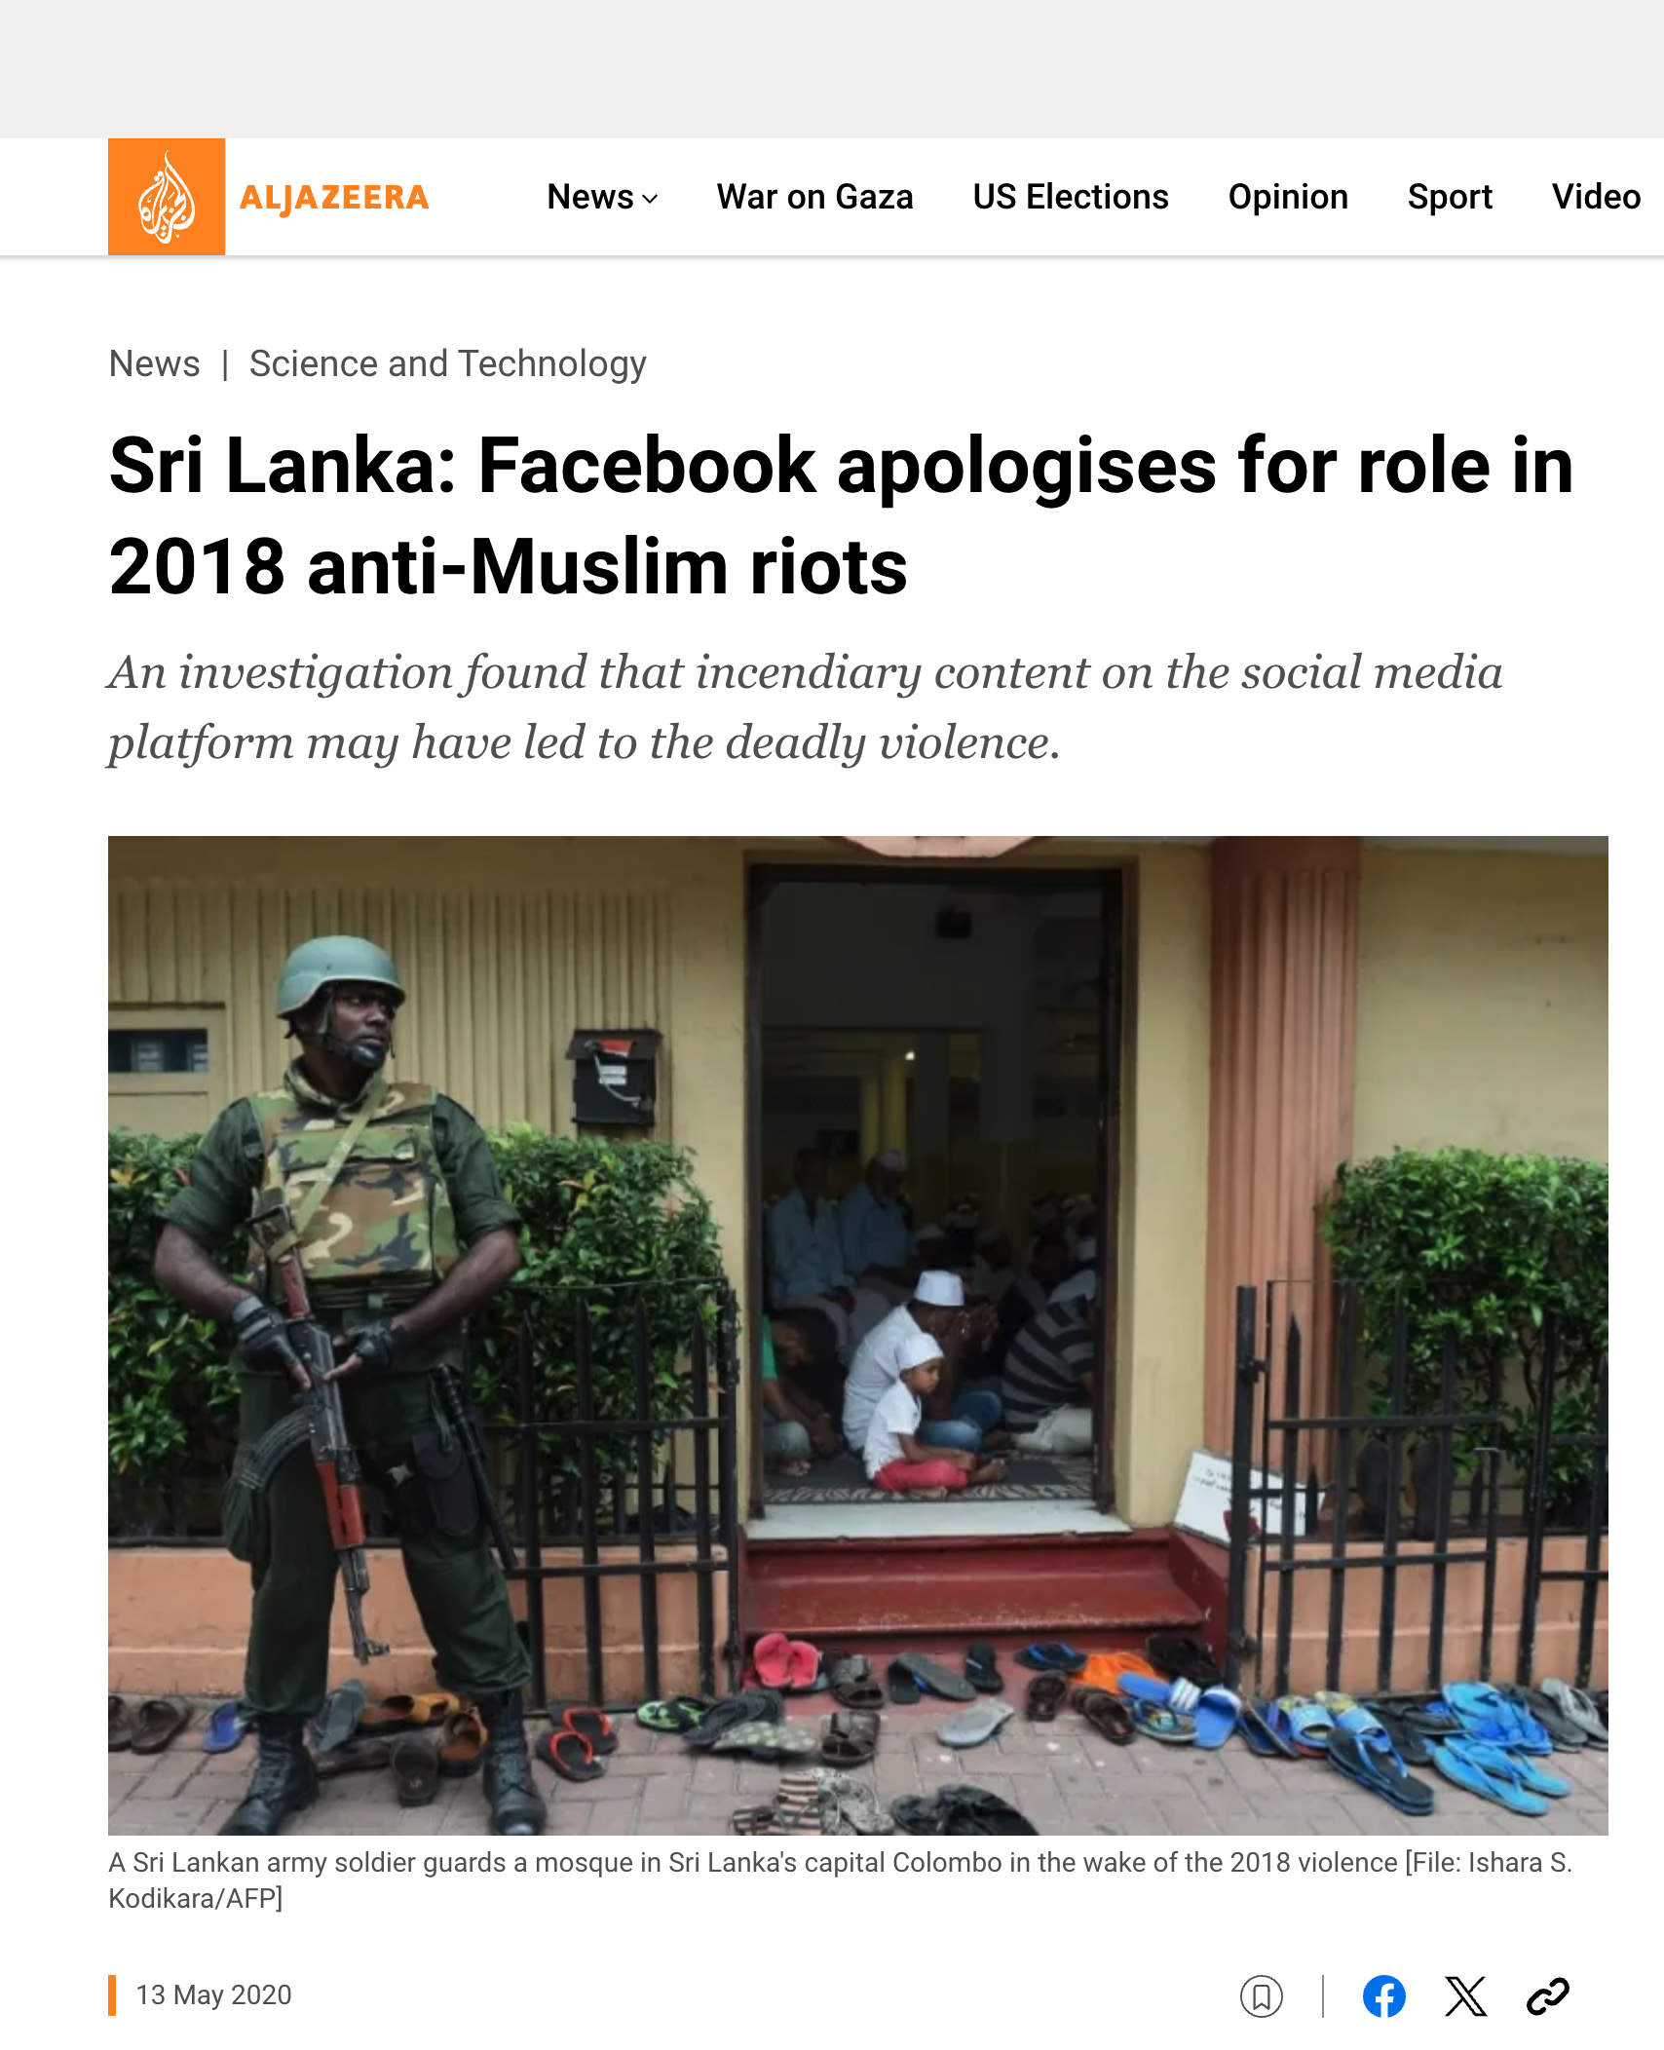

Deadly Consequences

Slide 16
Concerns
Responsible AI (deadly and insanely profitable)
Data quality
Too much machine translation
Too few quality controls (by people with local expertise)
Lack of Expertise in Languages and Cultures
Too much Emphasis on Translation
Is it appropriate to use English as a pivot language
Is there a single model to rule them all?
Covering multiple perspectives

Slide 17
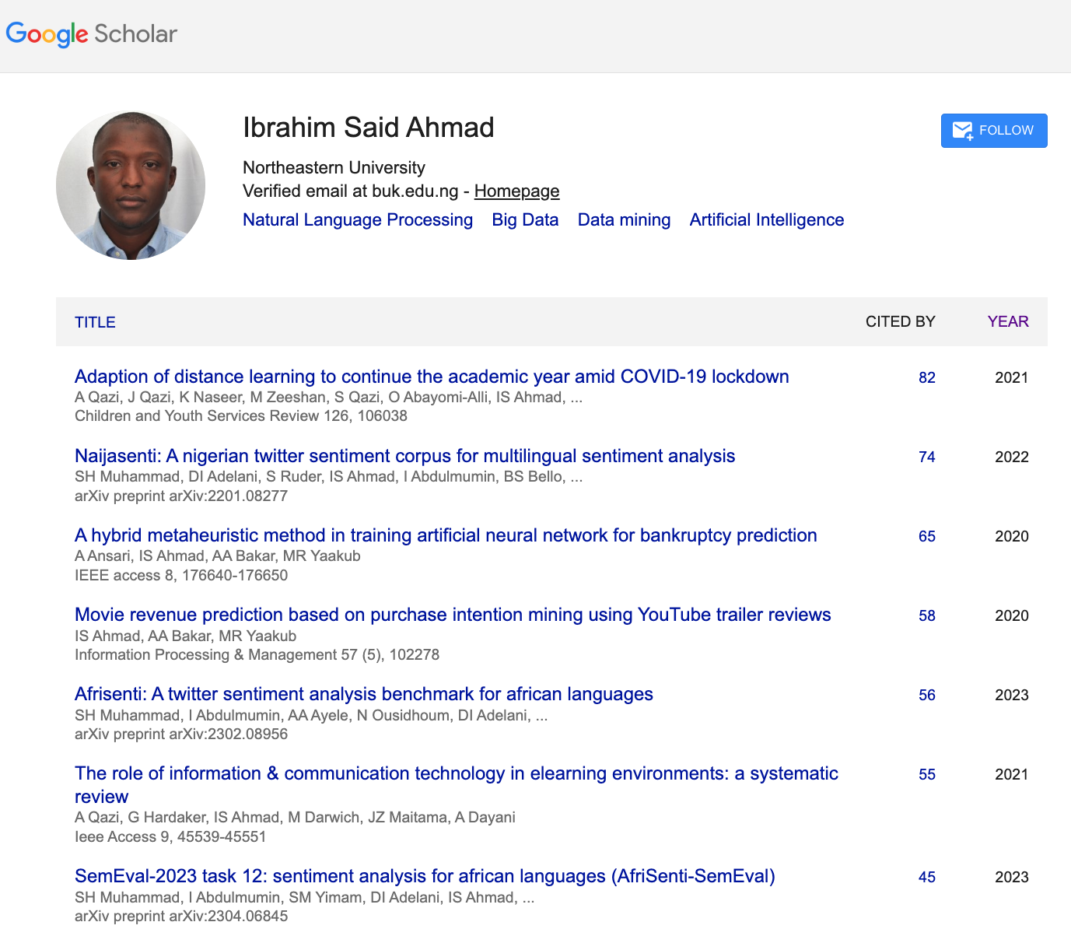
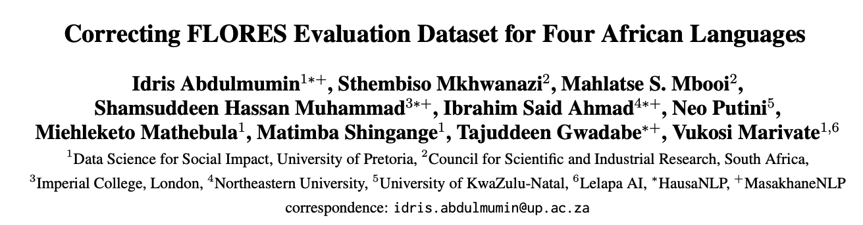
Engage Local Expertise
Hate speech is more toxic
in Hausa tweets than
in English tweets (in Nigeria)
Quality control is relatively weak in 4 African Languages
A significant part of the translations were suspected to have been automatically generated

Slide 18
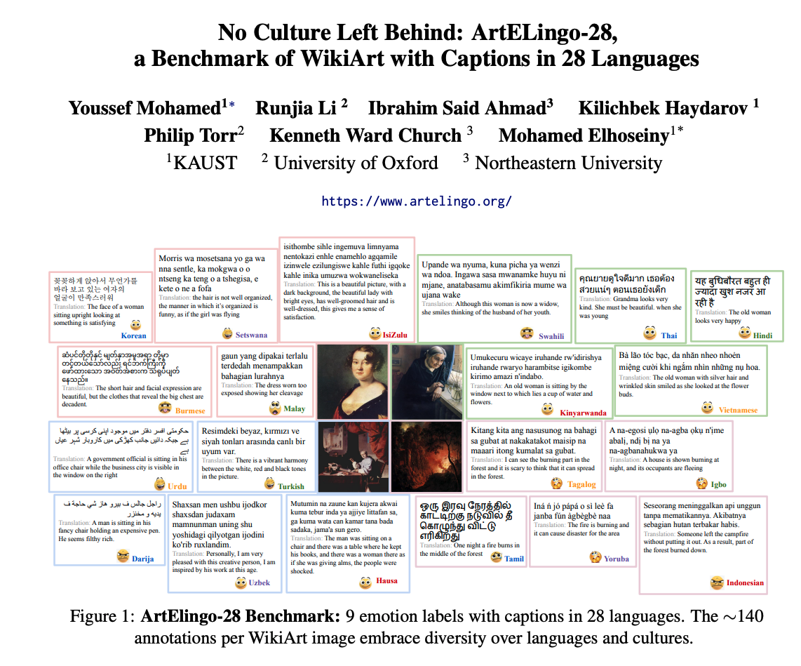
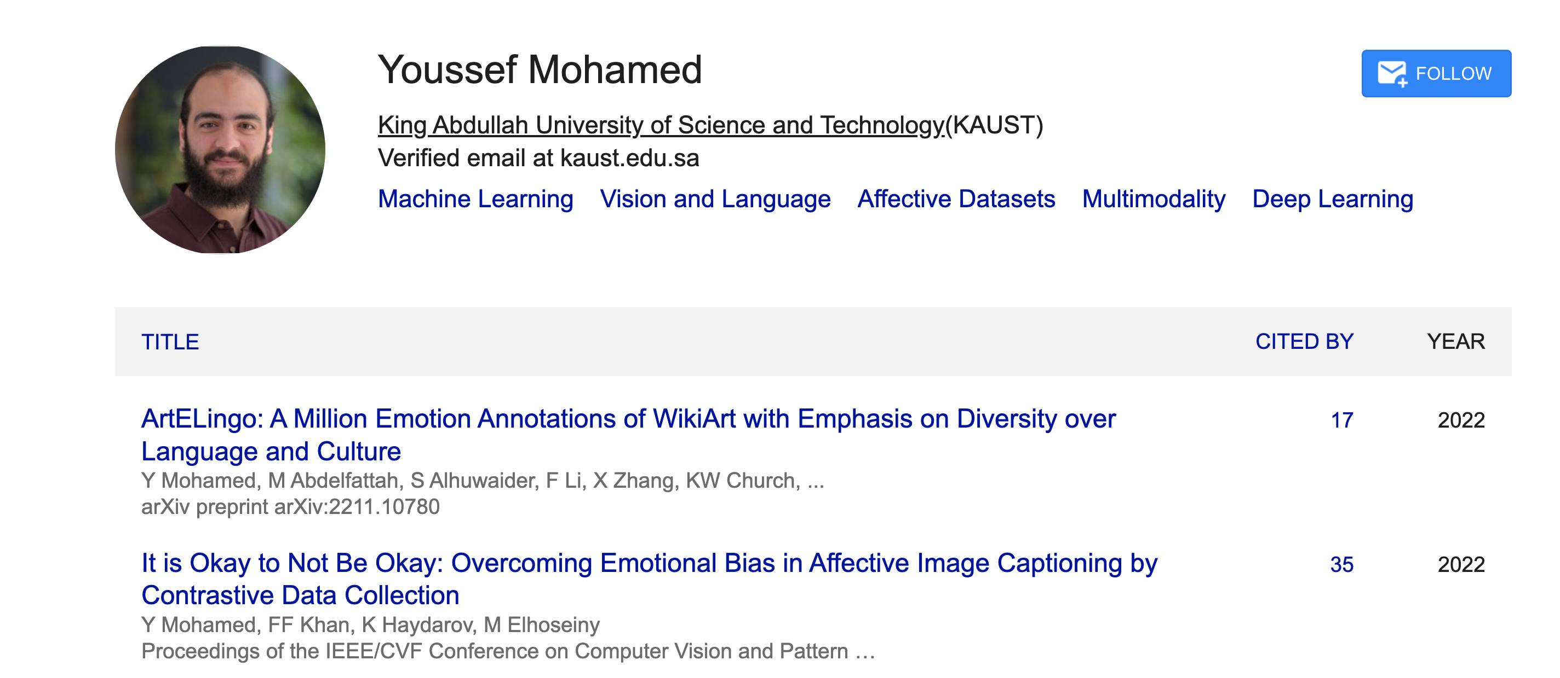
JSALT-2025 Teamwork Opportunity: Zoom → Face-to-Face

Slide 19
Concerns
Responsible AI (deadly and insanely profitable)
Data quality
Too much machine translation
Too few quality controls (by people with local expertise)
Lack of Expertise in Languages and Cultures
Too much Emphasis on Translation
Is it appropriate to use English as a pivot language?
Is there a single model to rule them all?
Covering multiple perspectives

Slide 20
Avoid Translation (Pivoting via English)
WordNet
NRC-VAD (Google Translate)
wn.synset('dog.n.01').lemma_names('fra')
['canis_familiaris', 'chien']
wn.synset('cat.n.01').lemma_names('fra')
['chat']
wn.synset('house.n.01').lemma_names('fra')
['maison']
wn.synset('bank.n.01').lemma_names('fra')
['banque', 'rive’]
Supports 32 languages
But not Quecha, Galician, Hausa, Tamil
English | Hausa | Valence | Arousal | Dominance
aaaaaaah | aaaaaaa | 0.48 | 0.61 | 0.29
aaaah | aaaah | 0.52 | 0.64 | 0.28
aardvark | ardvark | 0.43 | 0.49 | 0.44
aback | abin mamaki | 0.39 | 0.41 | 0.29
abacus | abacus | 0.51 | 0.28 | 0.49
abalone | abalone | 0.50 | 0.48 | 0.41

Slide 21
Concerns
Responsible AI (deadly and insanely profitable)
Data quality
Too much machine translation
Too few quality controls (by people with local expertise)
Lack of Expertise in Languages and Cultures
Too much Emphasis on Translation
Is it appropriate to use English as a pivot language
Is there a single model to rule them all?
Covering multiple perspectives

Slide 22

Lack of Perspective in Chatbots
Homework for students in my NLP class
Write essays on Opium Wars
from six perspectives
including East and West
Feel free to use online tools:
chatbots, search, etc.
(but you are responsible for the content)
Chatbots view everything
from a single (American) perspective
Concern: even international students
handed in essays from Western perspective,
though they were taught another perspective in China
When bots over-simplify the truth,
and take our side of a conflict,
that could be dangerous
and could lead to a trade war,
if not a shooting war.

Slide 23
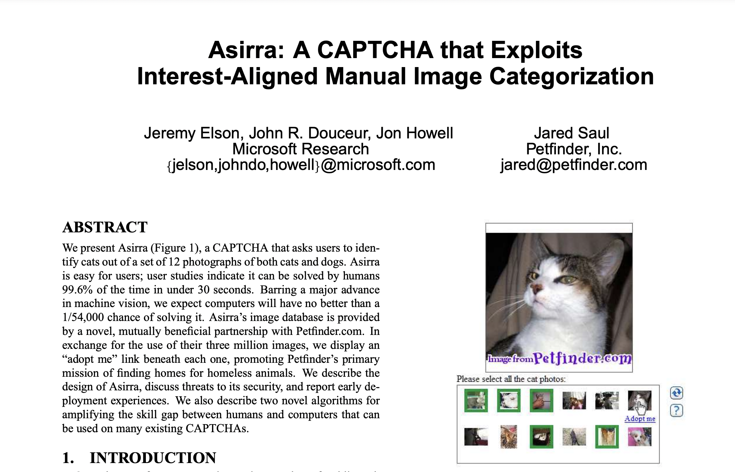
Adding Perspective to Vision Research: Vision is more than classifying pixels
https://www.microsoft.com/en-us/research/wp-content/uploads/2007/10/CCS2007.pdf

Slide 24
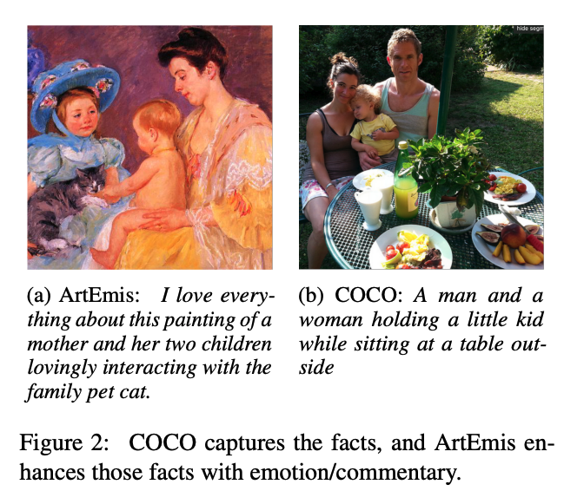
Adding Perspective to Vision Research COCO (Objective) → ArtEmis (Subjective)
Subjective Emotion
Objective
Facts
More room for Audience Background:
Culture/Language

Slide 25
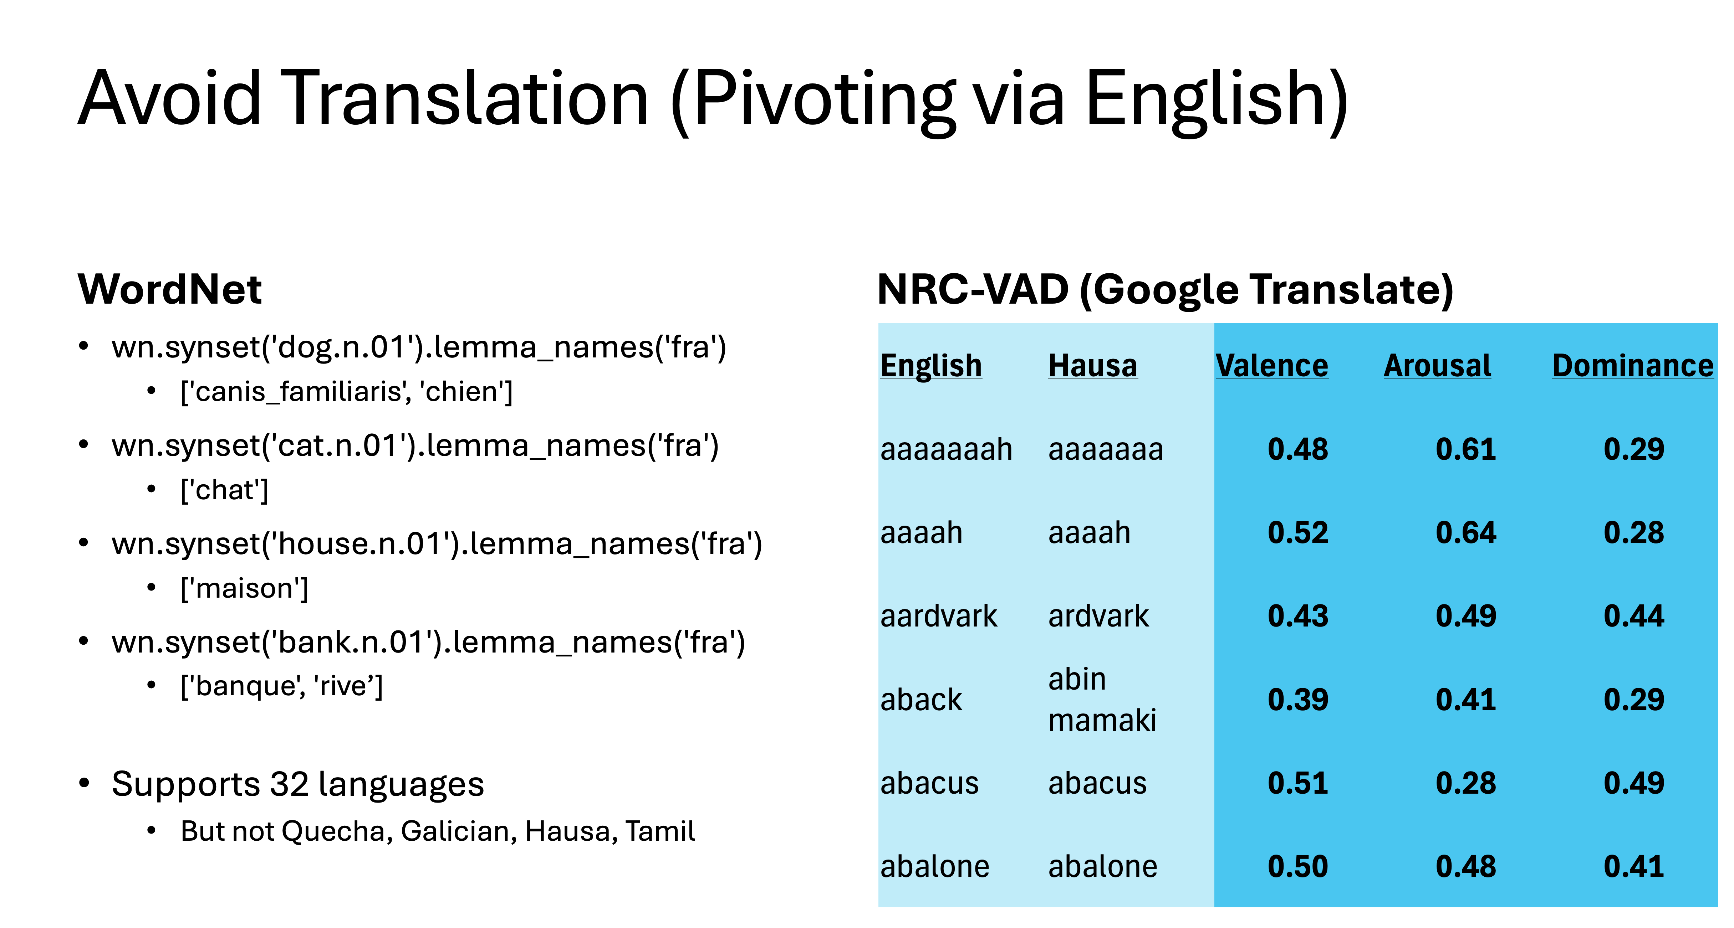
Adding More Perspectives to Vision (Do not pivot via English)
Input: Artworks
Annotations:
9 Emotion Labels
4 Positive:
Contentment, Awe, Excitement, Amusement
4 Negative:
Sadness, Anger, Fear, Disgust
1 Neutral
Captions in 28 languages
English glosses added to paper
to help readers (but not in corpus)

Slide 26
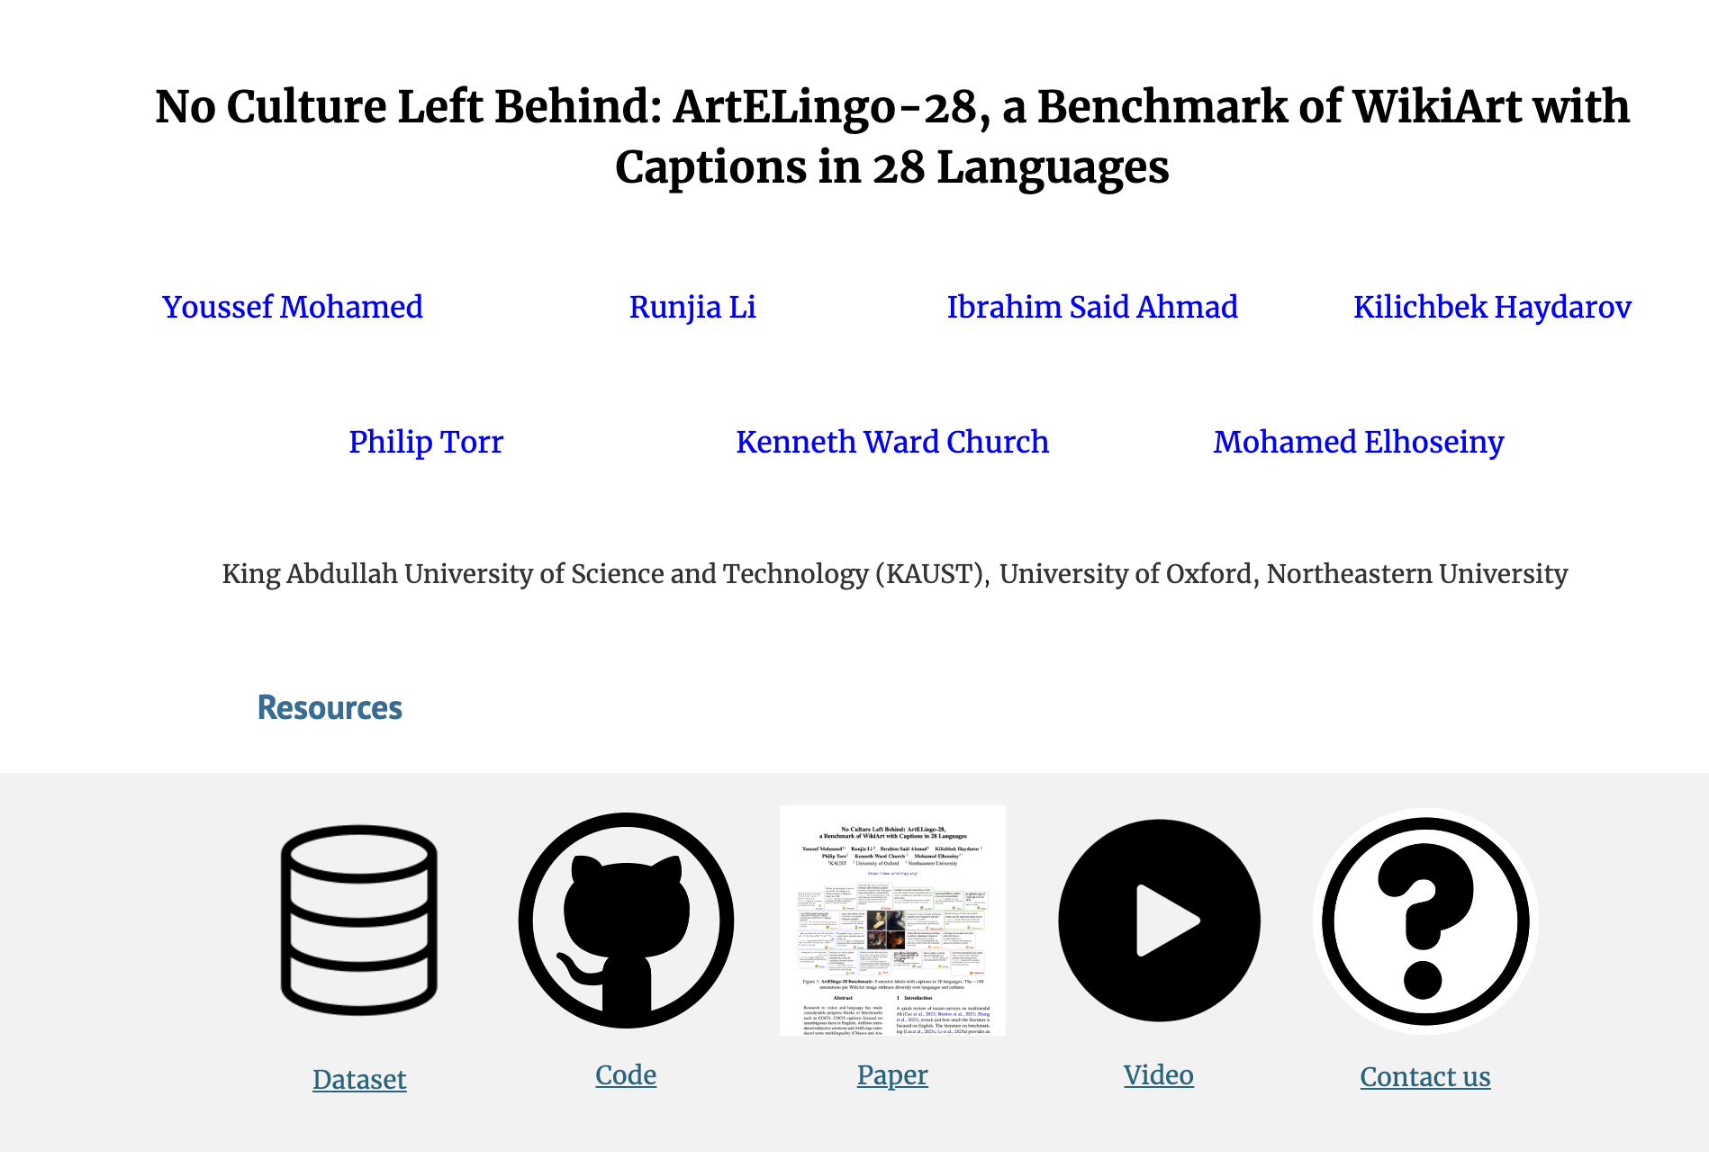

Website: Data, Code, Paper & Video

Slide 27
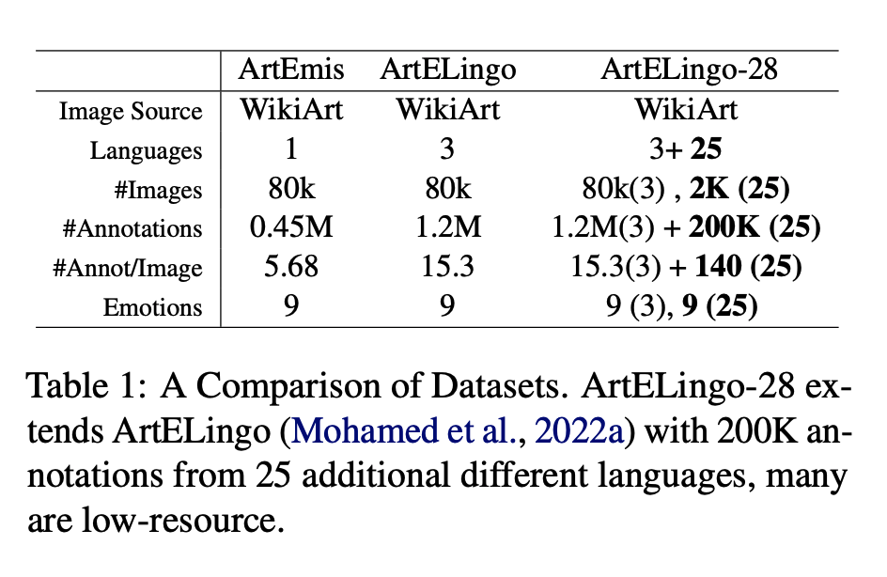
Quality Control
Benchmark | Languages | Annotators | Annotation Hours | Coordinators | Coordinator Hours
ArteLingo | 3 (en, zh, ar) | 7.8K turkers | 32K | 3 students | ??
ArteLingo-28 | 28 | 220 | 6.3K | 32 | 2.5K

Slide 28
Embrace Diversity & Multiple Perspectives
emotion labels:
disgust (Burmese)
awe (Malay)
captions focus
on chest
Burmese & Malay
on face and hair
Korean & Setswana
Hypothesis:
Predictable
Ethics Review

Slide 29
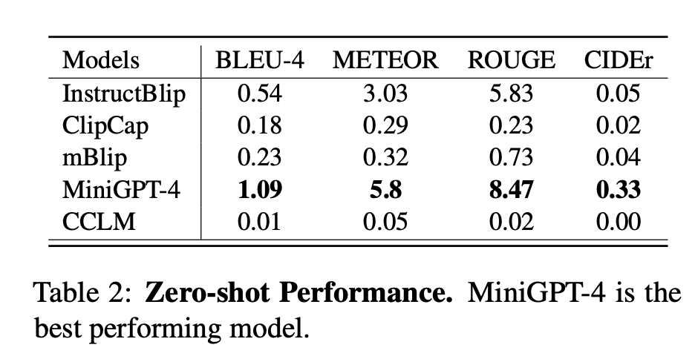
Three Boot-Strapping Tasks: Zero-Shot, Few-Shot and One-vs-All Zero-Shot
In the Zero Shot setting,
the system is trained on Arabic, Chinese and English,
and tested on 25 other languages

Slide 30
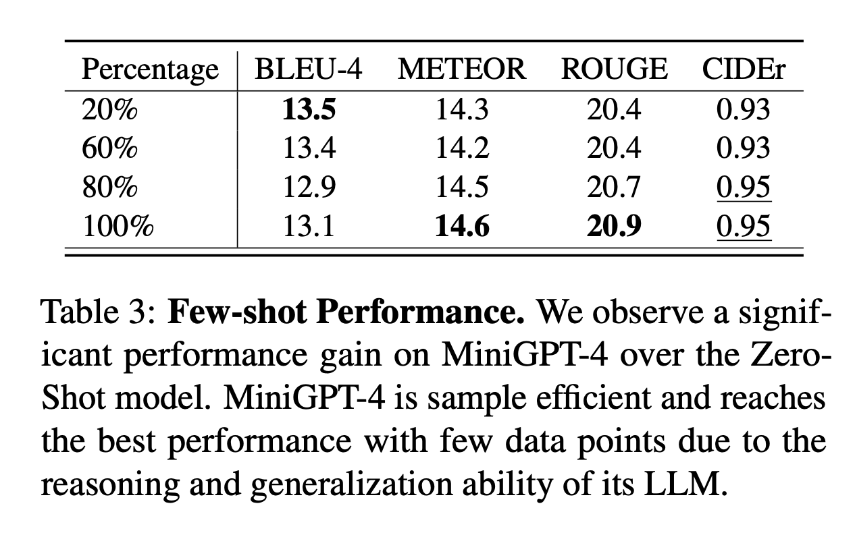
Few Shot >> Zero Shot
Scenario:
we have a modest amount of data (∼7K) from low resource languages
in addition to large amounts of data (∼900K) from high-resource languages.

Slide 31
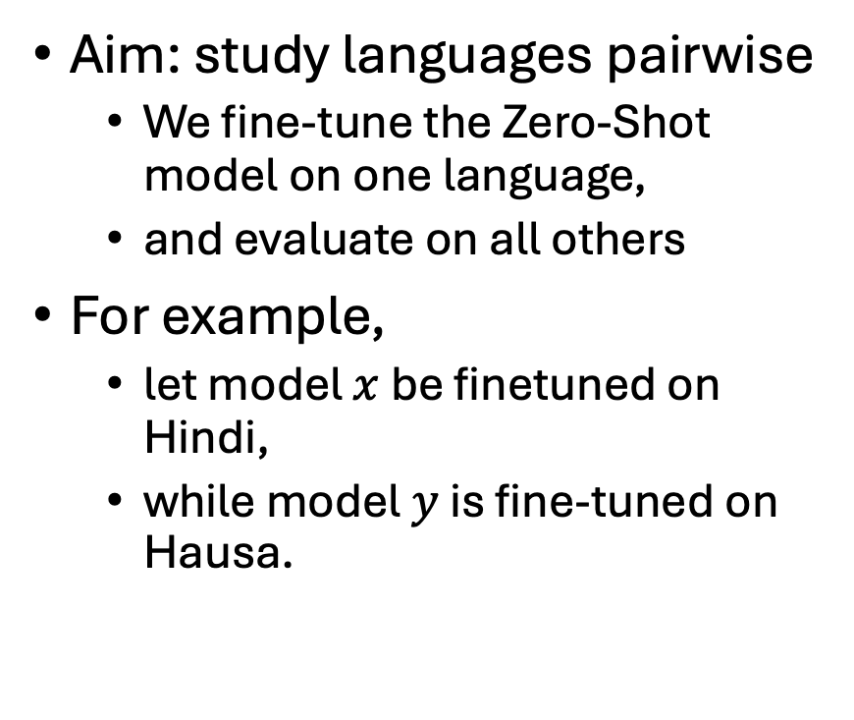
One-vs-All Zero-Shot
Aim: study languages pairwise
We fine-tune the Zero-Shot model on one language,
and evaluate on all others
For example,
let model $x$ be finetuned on Hindi,
while model $y$ is fine-tuned on Hausa.
Evaluate both models on Urdu.
If both models perform similarly,
then there is no underlying cultural relationship between Hindi or Hausa with Urdu.
However, we learn that
Hindi is more like Urdo
than Hausa

Slide 32
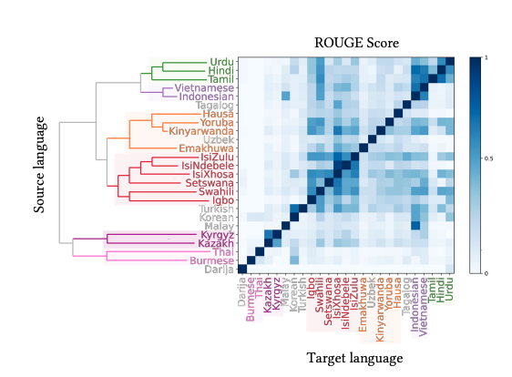
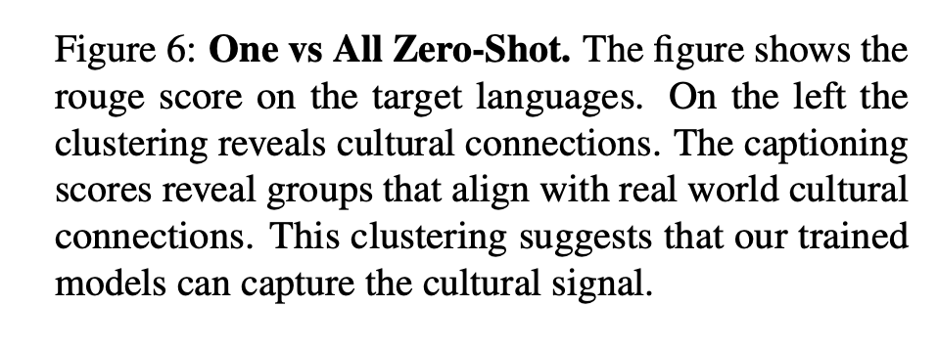

Slide 33
Vision: More than Pixels Communication (Shannon): Audience Matters
Art is a form of communication
between artist and audience
Background matters
Language
Culture
Task: Art, Lang → Caption
English pivot baseline:
Translate caption from English
Can we beat that?

Slide 34
Deliverables
Data
Methods
Survey Available Resources
Good News: More than expected
Bad News: Mixed Quality
Re-use when possible
Create when necessary
Boot-Strapping
Take advantage of high resource langs
To make progress on growth langs
Three Boot-Strapping Tasks:
Zero-Shot
Few-Shot
One-vs-All Zero-Shot
Multi-Modal
Language
Vision
Speech

Slide 35
Deliverables
Survey current status
Identify available resources
Evaluate strengths and weaknesses
Engage Local Expertise
Bring together people
that would not normally work together
Establish that we can do
better than pivoting via English
on tasks: captioning, toxicity classification
Resources
Re-use (or create, if necessary)
to encourage more research
on growth languages
embracing diversity
and multiple perspectives
Develop a catalog/hub for
datasets, models and other resources
like HuggingFace
Inclusive playground for
Sharing: Encourage community to upload resources
Ease-of –Use
Easy to find popular stuff
Easy to try things out
(without downloading)
Gamify Annotation
Make annotation fun
Like the ESP Game
Bootstrapping Methods

Slide 36
Project Overview
Low Resource Languages
Growth Languages
Quechua (Peru)
Galician (Spain)
Plan (6 weeks)
Collect resources (2 weeks)
Improve perf of MT & NLP (3w)
Distribute models/corpora (1w)
Hausa (Nigeria)
Tamil (India)
Plan (6 weeks)
Resources
Survey available resources
Assess Quality
Re-use and build (if necessary)
Hub / Gamify (ESP Game)
Beat Pivot-via-English Baseline
Bootstrapping Methods

